Slide 1
STATION NAME INDICATOR IN TRAINCOACH FOR INDIAN RAILWAYS
PRESENTATION ON PROJECT
PROJECT MEMBERS:-
ROCKY BHUSHAN (ECE)

Slide 2
FLOW PROCESS CHART
Identification of problem
Problems with earlier system. i.e., GPS system
Using of Electronics & Mechanical Devices
Safety Measures

Slide 3
NECESSITY OF THE PROJECT
Easy indicator system
Know the station name very easily
No Difficulty in the time of night or fog
Easy to display the station names even in hill station, Where generally gps doesnot work.

Slide 4
Problems identified
Station identification in the night.
Difficulties to find exact location.
Curiousness about the distance.
Difficulties in the fog,.
Time specification to reach the destination.

Slide 5
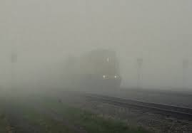
Difficulties in the winter season
FOG

Slide 6
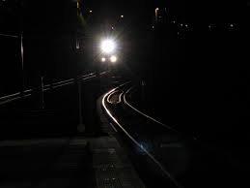
IN NIGHT

Slide 7
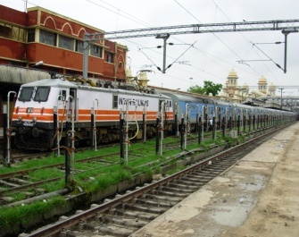
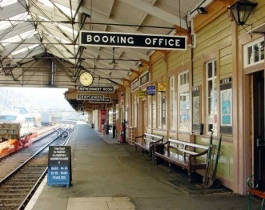
Alternate Solution
Generally peoples are use GPS to find the exact location.
Internet
Passengers

Slide 8
PROBLEM IN GPS SYSTEM
Due to improper network there is the problem to find the exact location by using GPS.
There are some passengers ,which have not a mobile phone so this is difficult task for these type of passengers
With the use of station name indicator we can make the journey more comfortable

Slide 9
PROPOSED SOLUTION
In our project the station indicate by mechanical and electronics devices
The exact location with the help of distance measurement device.
We can show the distance b/w two stations

Slide 10
Comparison b/w GPS & Our System
GPS SYSTEM
ONLY DEPEND O N SATTELITE
COST IS VERY HIGH
NECESSARY OF MOBILE PHONES
NETWORK
OUR SYSTEM
NO NECESSITY OF SATTELITE
LOW COST
MOBILE PHONE NOT NECESSARY
EASY TO KNOW THE STATION IN ANY WHERE IN THE COACH

Slide 11
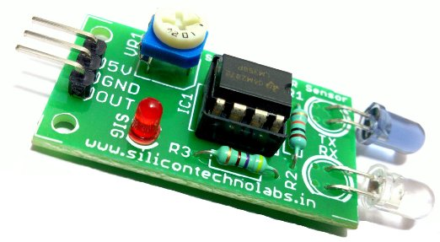
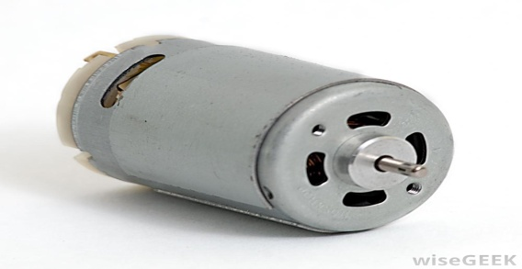
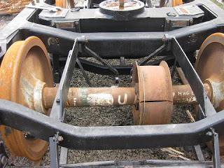
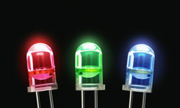
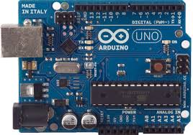
REQUIRED COMPONENTS
MECHANICAL
ELECTRONICS
IR SENSOR FOR RPM MESURMENT
DISPLAY DEVICES (LED) &(LCD)
MICROCONTROLLER
1.Pulley
2.Gear
3.Bearings
4.Nut & bolts
5.Shaft

Slide 12
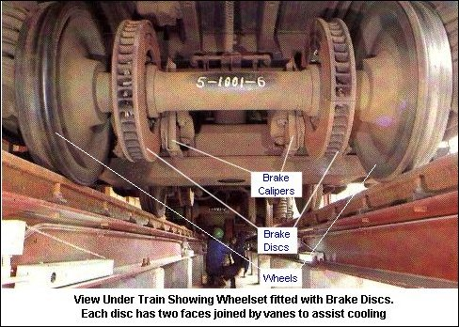
MECHANICAL ARRANGEMENT(RAILWAY WHEEL ARRANGEMENT)

Slide 13
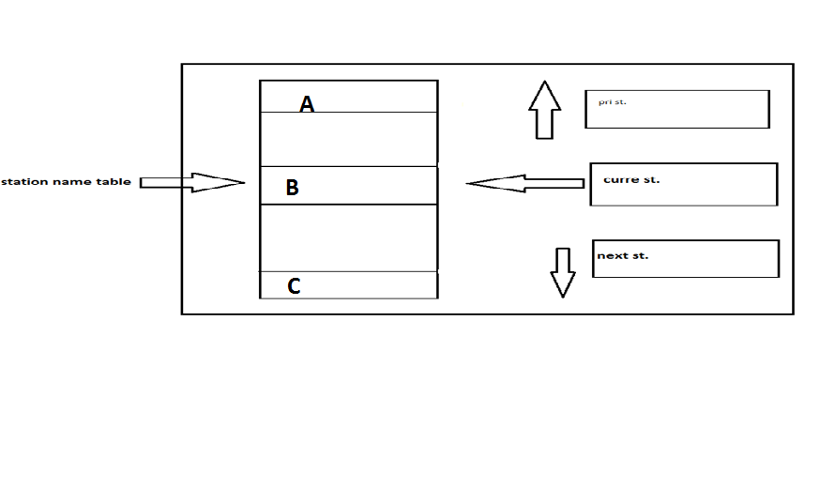
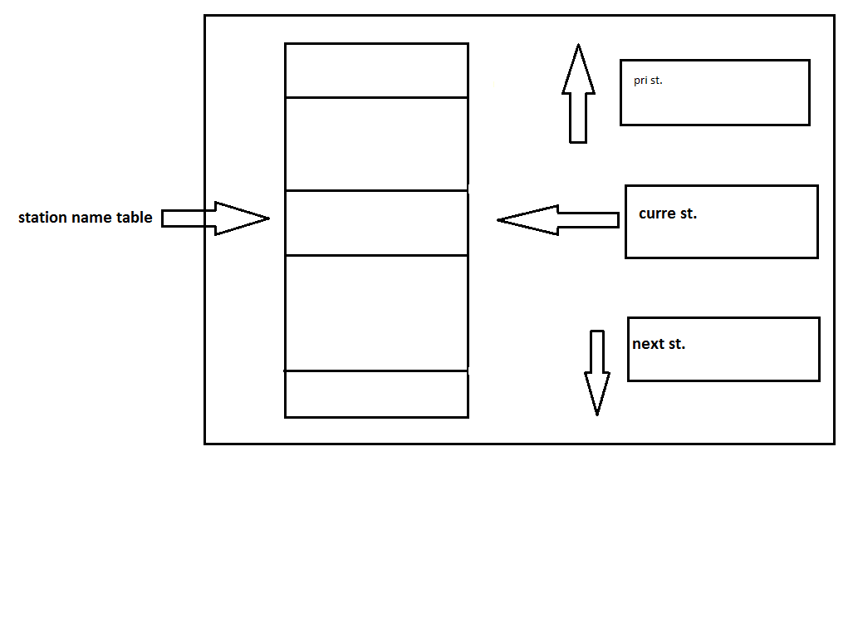
INDICATOR BOX
MECHANICAL INDICATOR BOX

Slide 14
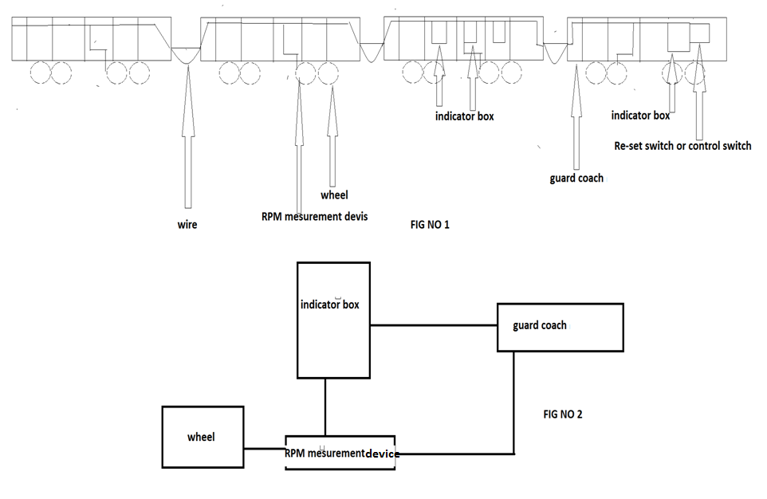
CIRCUIT DIAGRAM

Slide 15
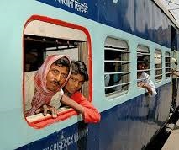
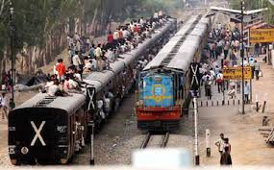
For whom we are developing
Mainly for passengers inside the train.
For all Passenger and all sleeper coaches.
Which passengers doesn’t use mobile
Mental peaceful journey for a common man

Slide 16
SAFTY MEASURE
USE ALARM SYSTEM
COVER WITH GLASS
COVER WITH IRON RODS

Slide 17
Work Completed
Mechanical work is almost completed
We have taken a wooden piece of 3/3
Over the wooden piece two chainers are placed
On the chainers two bearings are mounted
One shaft is mounted within the bearings
One Dc motor is attached to the shaft

Slide 18
THANK YOU
Notes:
THANKS.

